Slide 1
Pokémon Classification Project
Charles Hyland 450411920
Rowena Kok 440256380

Slide 2

Meet Ash
Aspiring Pokémon Trainer
Loves battling new Pokémon
Often in regions with little medical facilities

Slide 3
There’s more.
Attacks on Pokémon trainers rising
Capacity to analyse unidentified Pokémon is falling

Slide 4
Our Solution - PIRA
Pokémon
Instant
Recognition
Application
Notes:
Tracks stats of Pokémon during battle
Realtime statistical analysis on what kind of Pokémon it is
- Able to take photos of Pokemon

Slide 5
Business Application
Wild Pokémon appearing
Trainers getting attacked
Cities getting ruined
Notes:
How can we apply PIRA?
Help solves all these

Slide 6
Our Development.
Exploratory Data Analysis.
Model Evaluation.
Deployment
Model Training.

Slide 7

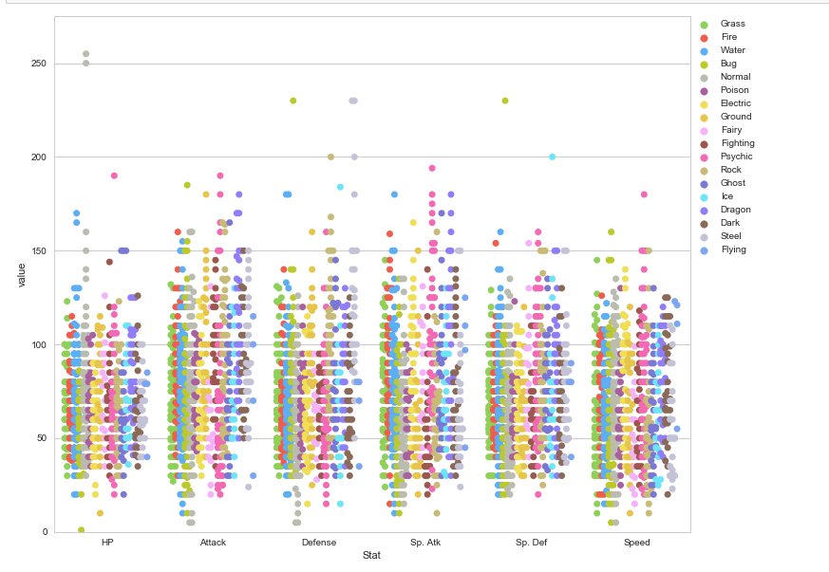
Data Exploration
Data is of a high quality
Attributes evenly distributed
Water and Normal type Pokémon most frequent
Notes:
- There appears though that some Pokémon have differentiating factors

Slide 8

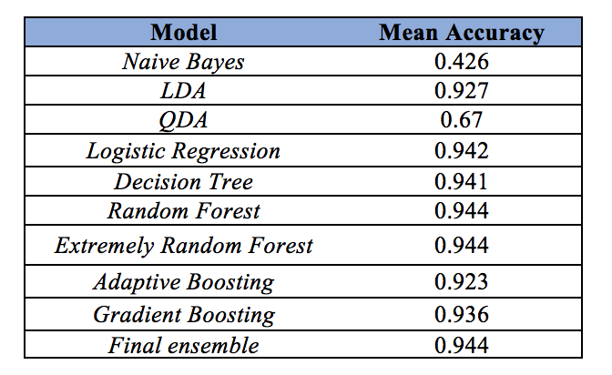
Results.
High accuracy in models we have constructed
Strong performance
94% accuracy rate
Notes:
Tried out multiple models
Our models are focused on predictive capabilities and not interpretability since we want to be able to identify Pokémon quickly
Final result at the bottom has the best results but was too slow
Therefore, we chose a model that was significantly more simple, yet still gave us robust and just as good results.

Slide 9



Applications.
Able to save Pokémon trainer’s lives
Improve efficiency of identifying Pokémon
Save cost and time in identifying Pokémon
Notes:
With this, PIRA can achieve our business objective and able to satisfy all these applications to our business case scenario.

Slide 10
Thank You!

